Slide 1
Volunteer mileage Reimbursement Process
Turn up volume and follow along

Slide 2
Need three documents
W-9 Form
Mileage Reimbursement Form
Image of Google Maps Route
Use the resources page linked below to access the Forms. https://casa.franklincountyohio.gov/Volunteer/Resources

Slide 3
W-9 form
Fill out once per year.

Slide 4
Mileage reimbursement form
 | Volunteer Mileage Reimbursement
 | Volunteer Name: | John Smith |  | Milage Rate as of 2023
 | Mailing Address: | 1234 Main St. Anytown, OH 4XXXX |  | $0.14
 | Date | Address / Location | Total Miles Driven Per Trip | Amount Requested For Reimbursement
 | 01/15/2023 | 4321 Joy Ct. Anytown, OH 4XXXX | 37 | $5.18
 | 02/14/2023 | 4321 Joy Ct. Anytown, OH 4XXXX | 37 | $5.18
 |  |  |  | $0.00
 |  |  |  | $0.00
 |  |  |  | $0.00
 |  |  |  | $0.00
 |  |  |  | $0.00
 |  |  |  | $0.00
 |  |  |  | $0.00
 |  |  |  | $0.00
 |  |  |  | $0.00
 |  |  |  | $0.00
 |  |  |  | $0.00
 |  |  |  | $0.00
 |  |  |  | $0.00
 |  |  |  | $0.00
 |  |  |  | $0.00
 |  |  |  | $0.00
 | Totals |  | 74 | $10.36
Each row is per address, as is the Google route.
In the last column, multiply the number of miles driven by 14 cents (or .14)
There is no audio for this slide. This form will calculate the mileage and rate for you as you enter the information.

Slide 5
Google Maps Image
The next few slides show you how to save a pdf of your route on Google Maps.

Slide 6
Tracking your route
1. 2.
Using Google Maps: https://www.google.com/maps
1. Click on directions in the top left corner of the screen
2. Type your starting location on the first line, and where you want to go in the box directly underneath it.

Slide 7
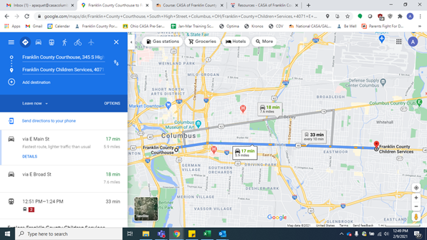
3. Pick your route

Slide 8
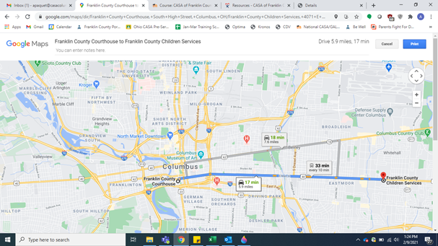
Ctrl+P
3. Select Route
4. Type Ctrl+P
Click on Print in top right corner
*You only need to submit one map per address, not per drive

Slide 9
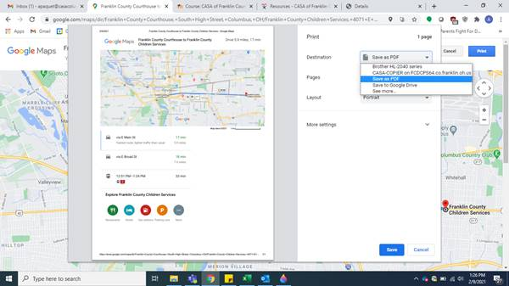
5. Use drop down and select save as pdf, then click save at the bottom

Slide 10
Submit Requests to Joanne Sheely
Reimbursements are as requested, submit as you wish.
Joanne.Sheely@franklincountyohio.gov

Slide 11
Contact casa with any questions

