Slide 1
How To check public records: Franklin county municipal court
Use this link to access the website and follow along Using the audio buttons on the top right corner of the slides

Slide 2
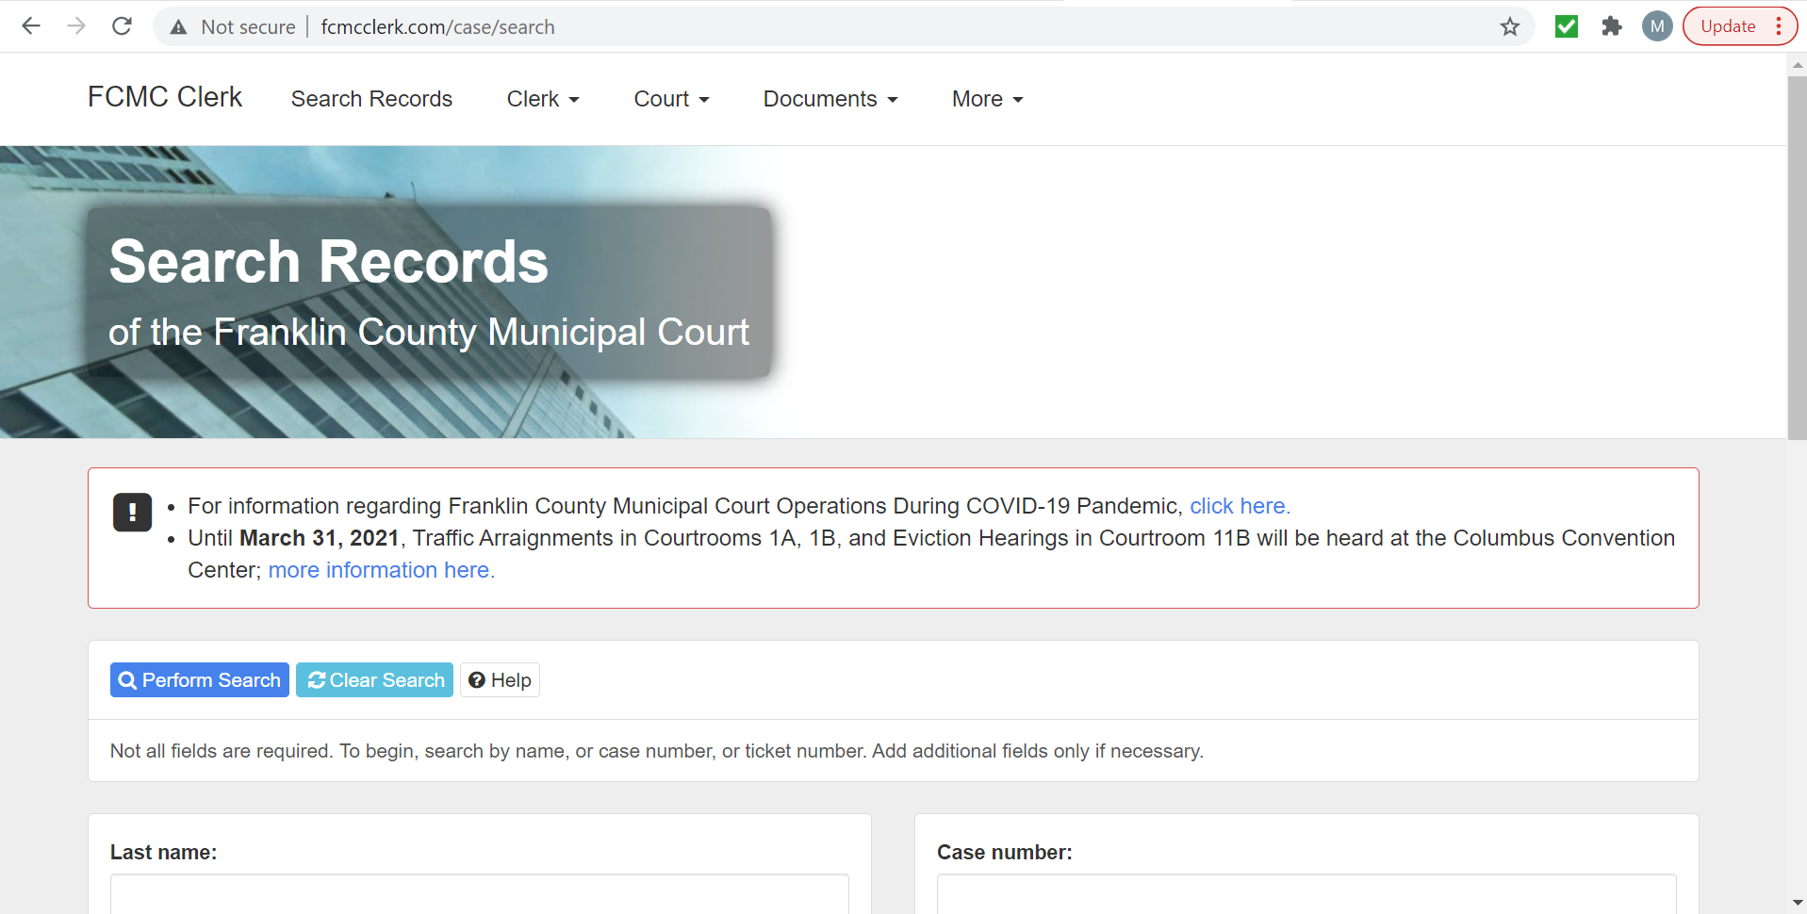
Screen should look like this
http://www.fcmcclerk.com/case/search

Slide 3
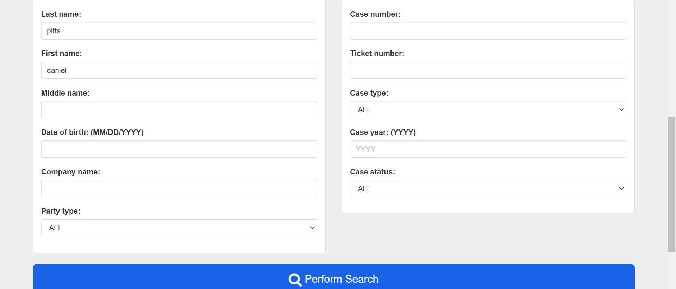
Search: last name, first name

Slide 4
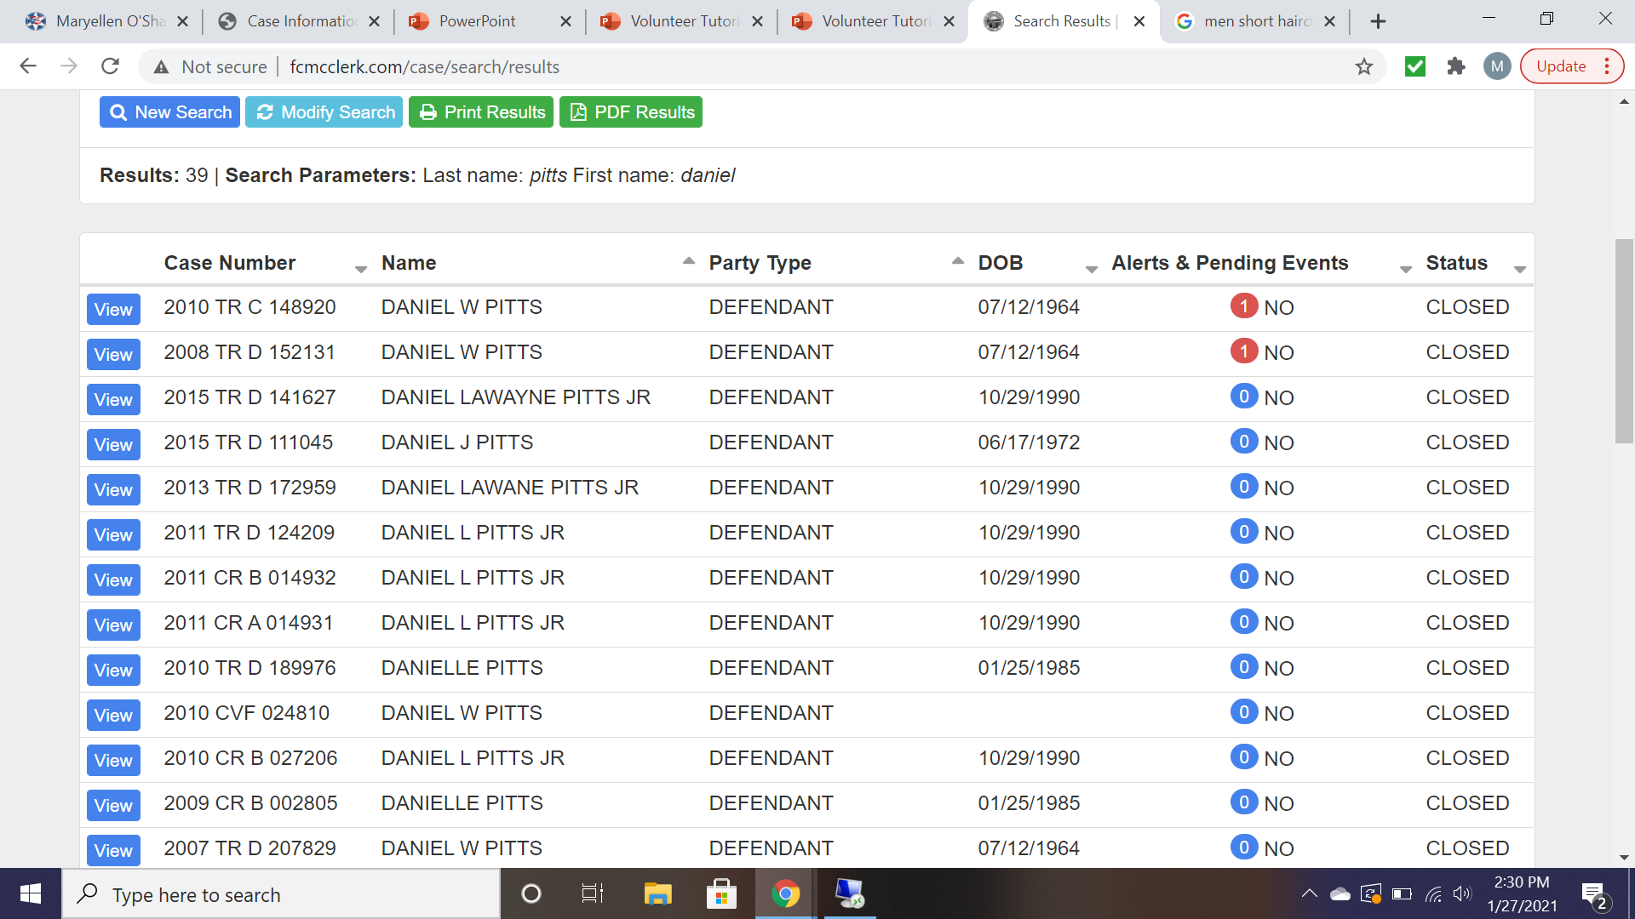
Results - Modify search

Slide 5
Alerts

Slide 6
Charges

Slide 7
disposition
Common Disposition Explanations

Slide 8
Contact Casa with any questions

