Slide 1
Add or Change placement
First, complete steps to add an associated party
(in slides above) You cannot create a placement with people if you have not added them as an associated party. If your child is in a facility, you can add them without adding an associated party.

Slide 2
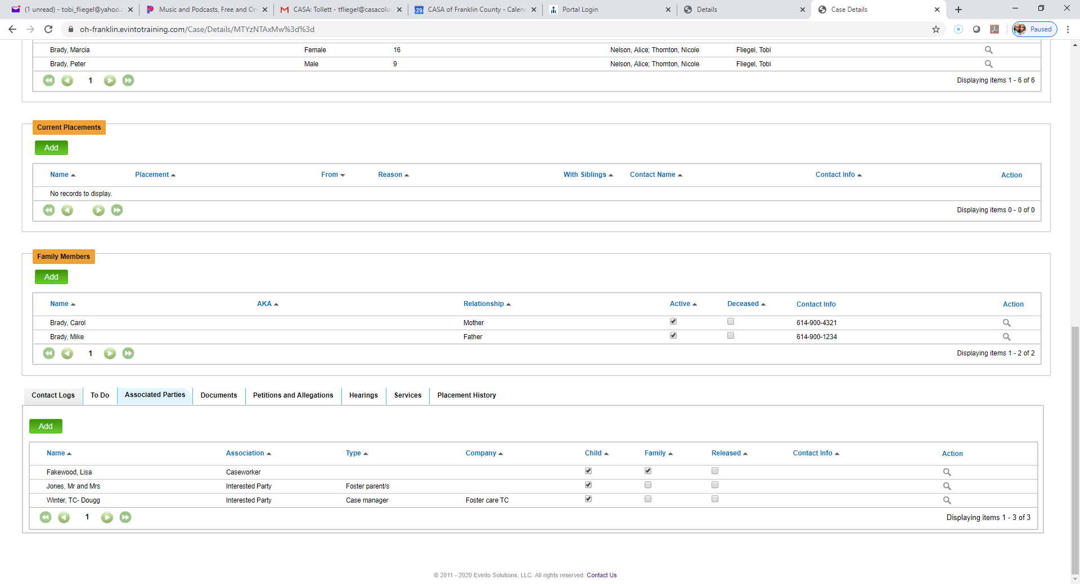
2. Click on Add under Current Placements
1. Make sure you have entered their information in and they are now showing up on your Associated parties list. …

Slide 3
1. Select only the children who the placement pertain to. If there are separate placement, you will need to go through these steps twice…
2. Select the interested party you entered previously…
3 finish filling out the information and click Create…

Slide 4
To change foster placements, you need to first add the new foster placement parent/s on the Associated party list…
Then, click Add…Repeat slide 14. The prior placement will automatically end on the date that the new one started…
Choose the new placement from the list of associated parties…

